Slide 1

CSS3: Flexbox
Method of positioning elements in horizontal or
vertical stacks.

Slide 2
“
The Flexbox Layout officially called CSS Flexible Box Layout Module is new layout module in CSS3 made to improve the items align, directions and order in the container even when they are with dynamic or even unknown size. The prime characteristic of the flex container is the ability to modify the width or height of its children to fill the available space in the best possible way on different screen sizes.
“

Slide 3
Why Use Flexbox Layout?
Simple to get started.
Easily center child elements, both horizontally and vertically.
Manipulate inline elements easily e.g. order and width.
Ideal for responsive layouts.
Complex layouts can be achieved with less code.

Slide 4








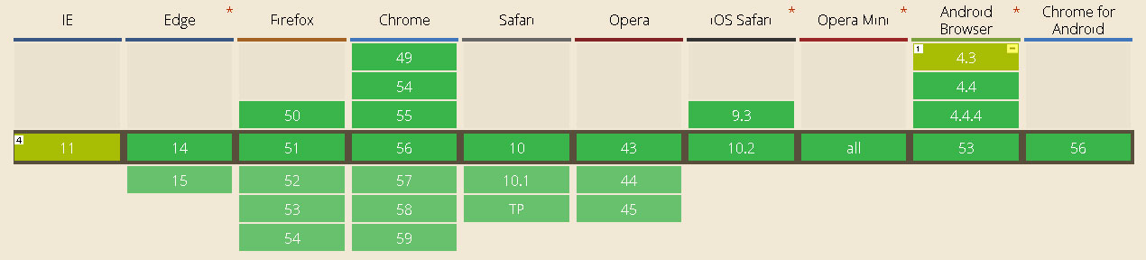
Browser Support
courtesy: caniuse.com
What about older browsers?
we can achieve flexbox support in older version of browsers by specifying vendor prefixes or by running our CSS through Autoprefixer, which handles the hard job for us very well.

Slide 5
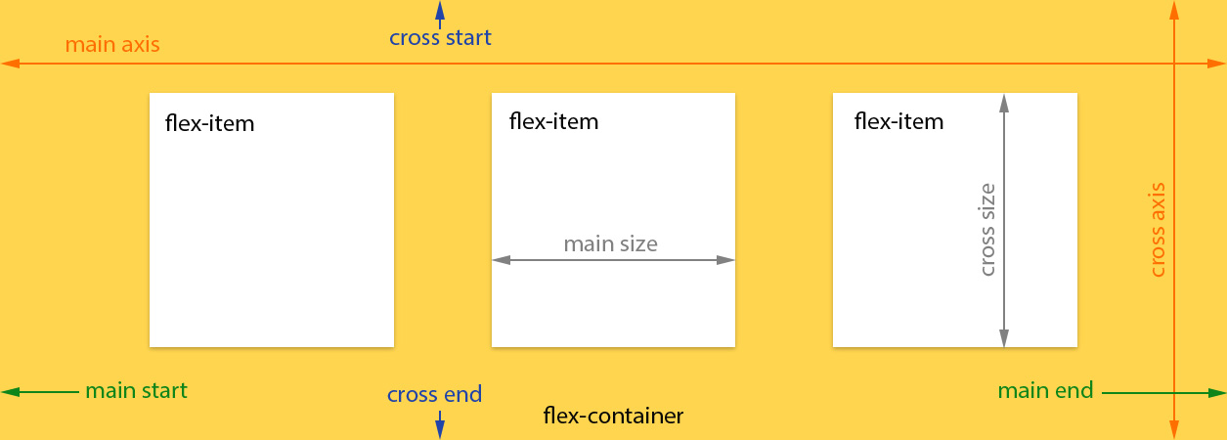
Concept
Flex container
Flex Items
courtesy: scotch.io

Slide 6
Flexbox Properties
Properties for the Flex Container (parent)
display: flex | inline-flex;
flex-direction: row | row-reverse | column | column–reverse;
flex-wrap: nowrap | wrap | wrap-reverse;
flex-flow: <‘flex-direction’> || <‘flex-wrap’>;
justify-content: flex-start | flex-end | center | space-between | space-around;
align-items: flex-start | flex-end | center | baseline | stretch;
align-content: flex-start | flex-end | center | space-between | space-around | stretch;
Properties for the Flex items
(childs)
order: <integer>;
flex-grow: <number>;
flex-shrink: <number>;
flex-basis: <length> | auto;
flex: none | [ <'flex-grow'> <'flex-shrink'>? || <'flex-basis'> ];
align-self: auto | flex-start | flex-end | center | baseline | stretch;

Slide 7
github.com/aamir1995

